Slide 1


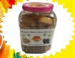

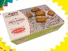
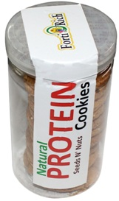
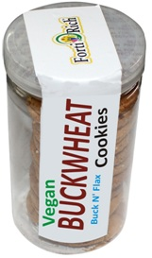
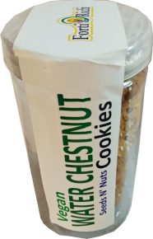






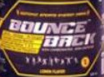
Food 4 Healthy Life

Slide 2
STRATUP PROJECT
SEEDS, Leafs N’ Grains PROCESSING
(Vegan protein rich, Gluten free source)
“INNOVATOR”
OM PRAKASH RANA
Vill. & PO – Harsi , Tehsil – Jaisingpur
Dist. – Kangra, HIMACHAL PRADESH
PIN - 176019

Slide 3
“Social Responsibility”
“thought”
Let us contribute to…
….What we have Destroyed
Grains with chemical & Pesticide
Fruits with chemical & Pesticide
Water with domestic & industrial effluents
Air with emission (COx, NOx,SOx…..)

Slide 4
Let us be……
“Responsible Generation”
Present
Journey towards……
“Healthy Generation”
Future

Slide 5
INNOVATION
Seeds, Leafs & Grains : Vegan Source & Food Ingredients
Our range of Vegan Cookies, cold brewed Himalayan organic tea, nutri bar, energy bar, nitro bar, cereals , porridge and noodles will promise to improve overall health of the community and promote wellness all over the world. Vegan source of ingredients is having medicinal properties. It prevents cancer, heart disease, asthma, & anemia, reduce the risk of gallstone improve bone health & digestion Boost Immune system Manage diabetes & Great source of Vegan protein, this has been proved by several universities all over the world. It has been authenticated by Ayurveda and Homoeopathy. Most of seeds contains Omega-3 Omega-6, Manganese, Magnesium, Iron, Copper, Phosphorus, Niacin, Zinc, Folate & Vitamin B6. The range of products what we will manufacture with seeds by doing Fortification of additional vitamins and micro nutrients make the products healthy and most suitable for the nutritionals requirements of peoples across.

Slide 6
Seeds , Leafs N’ Grains -- PROCESSING
Range of Seeds , Leafs & Grains based (+) Products
we are looking for…
Seeds & Grain (Vegan Protein) based Fortified Cookies
Organic Leafs Cold Brew Fortified Tea
Natural Grain Based Fortified Healthy Bars, Pearls, Cubes
Natural Grain, Nuts & Seeds Based Fortified Granolas
Natural Grain Based Fortified Healthy Premix
Natural Grain Based Fortified Healthy Porridge
Healthy Noodles
Multigrain, Gluten Free Fortified Flour
Targeted Category…
All FAMILIES – Multigrain, Gluten free flour
MOM’S FOOD - Healthy Drink Mix
LITTLE ONE FOOD – Porridge Mix
KIDS FOOD – Noodles & Cookies
YOUTH FOOD – Energy Bar, Protein Mix
WORKING CROWED FOOD – Healthy bar, Granola Mix
HIGH ALLTITUDE FOOD – Nitrate Healthy bar
AGGED CROWED FOOD – Healthy Porridge Mix

Slide 7

16 g
Vegan Protein
Vegan Cookies

Slide 8
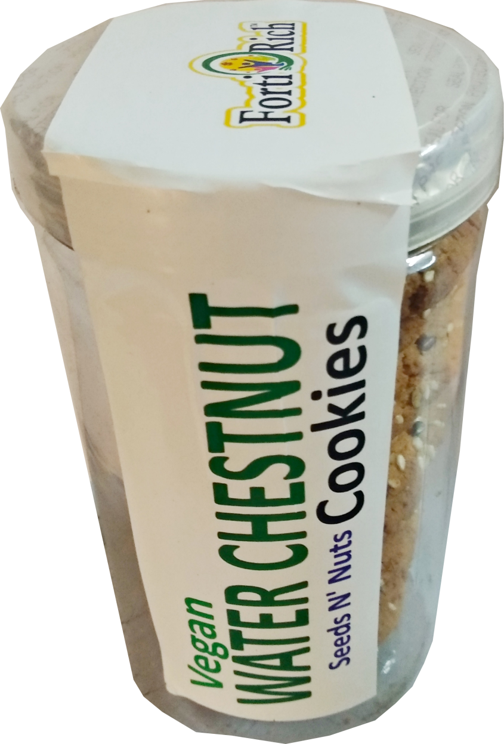

Rich Source of
Potassium
Vegan Cookies

Slide 9

14 g
Vegan Protein
+
Omega 3 & 6
Vegan Cookies

Slide 10
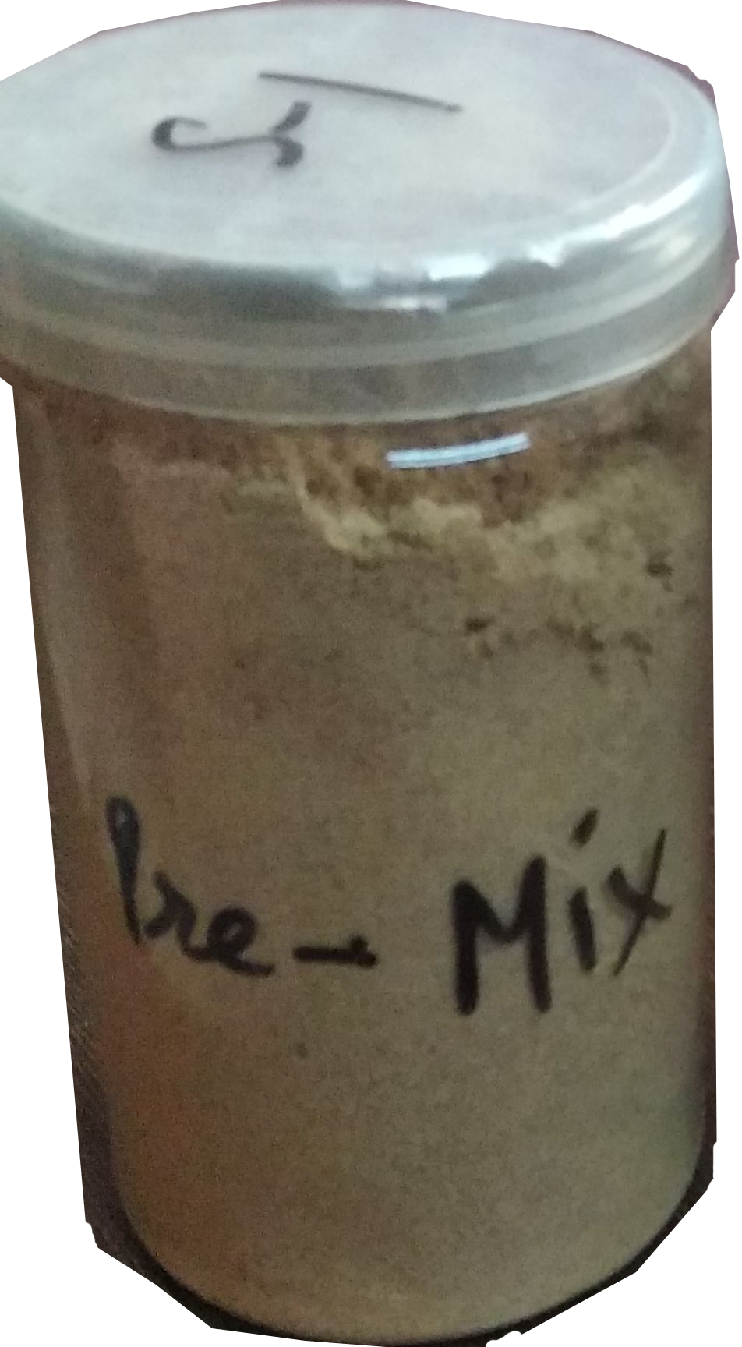
Healthy Pre-Mix
Complete Food for Kids from 6 months to 3 years. Full of Protein, micro nutrients, vitamins

Slide 11
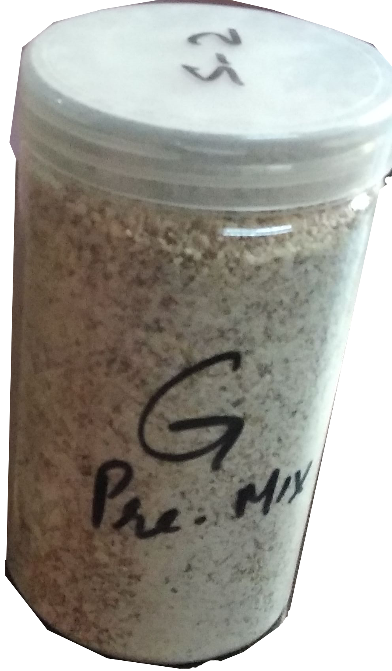
Granular
Healthy Pre-Mix
Complete Food for Kids from 3 years to 6 years. Full of Protein, micro nutrients, vitamins

Slide 12
6 GRAIN
KHICHDI MIX
RICE
MOONG DAL CHILKA
RAGI
RAJGIRA
JOWAR
BAJRA
Powerhouse of nutrients
& easily digestible

Slide 13
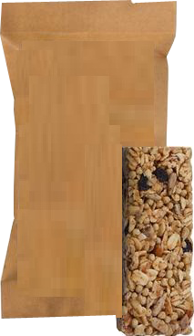
FortiRich
Multigrain
BAR
Multigrain Healthy Bar
Protein and Fibre Rich, Naturally Fortified and Nutritious with Oats, Millets and Almons

Slide 14
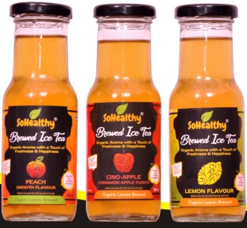
Cold Brewed Organic Tea
Rich source of Antioxidants
Helping weight loss, stress reduction, osteoporosis & fighting tumors

Slide 15
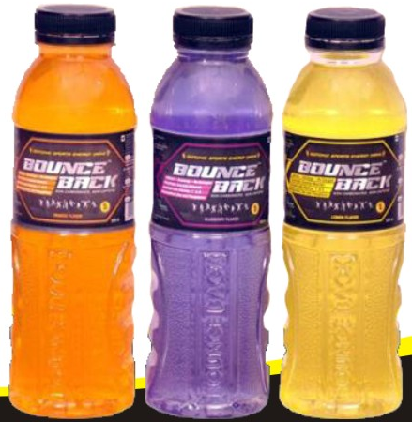
Non Caffeine Non Carbonated Energy Drink
Keep every body fit in every situation

Slide 16
MARKET POTENTIAL
Peoples in India & World across now forced to change their approach to “Pro-active” against “Re-active” as well as health is concern and always looking for functional foods who keep them fit and fine in their busy life schedules. These Products with medicinal, health and wellness properties are at demand in the market. Emerging trends like increased preference on wellness, desire to spend extra on health and maintaining healthy style in all segment of the market.
MARKETING PLAN
Marketing of all the products will be started with our existing network of modern trade B2B & B2C i.e. WalMart, Metro Cash & Carry, D-Mart, Spar Maxhyper, All-in Stores, SmartWife Stores and other individual stores and Delhi/NCR local market. Step by step we will expend the market to other states. For these products we have an opportunity to sell these products on online platforms like Bigbasket, Grofer, Nature Basket, Amazon & Flipkart etc..

Slide 17
SELLING STRATEGY
Creating eye-catching campaigns by putting up online popups banner with modren trades websites, indiamart & tradeindia portals and google ads. Participation in Trade Fairs like AHAAR Delhi, Annapoorna Mumbai etc.. Introductory bulk SMS carrying wellness information. Product launching special discount to consumers in modern trades and every level of sales chain i.e. SS, Distributor, Retailer & end consumer.
Product Standardization
Sales Forecasting

Slide 18

EXITING INFRASTURCTURE
Food Manufacturing
Beverage Manufacturing
DESILE FIRED OVEN – 52 TRAY : 3Nos.
Sugar Grinder - 1 Nos.
Flour Swifter - 1 Nos.
Spiral Mixer - 3 Nos.
Shrink Tunnel - 1 Nos.
Chest Freezer 500ltr. – 2 Nos.
Tray Sealer - 2 Nos.
Foil Sealer - 1 Nos.
Band Sealer – 1 Nos. Semi Automatic
Paddle band Sealer - 1 Nos.
Crafting Tables
Product Packaging Tables
Inkjet date coding machine
Office infrastructure like Computers, Printers etc
Heating Tank– 1000 ltrs - 1Nos.
Heating Tank 500 ltrs - 1 Nos.
Product Feeding Tank 500 lts - 1 Nos.
Bottle Filling Machine 40 bottle / minutes
Bottle screw capper
Bottle lug capper
Bottle cooling tunnel
Online labeling machine
Online inkjet date coding machine
Bottle inspection table
Bottle washing unit

Slide 19
A&SP Fund
(Advertisement, Sampling & Promotional Activities Fund)
Rs. 20 Lakhs
Prior launch fund - Rs. 10 Lakhs
(Branding, Labeling, Packaging, leaflets, Banner, trade registrations etc.)
2. During launch – Rs. 5 Lakhs
(Sampling, Campaigning etc.)
3. Post Launch – (5% of turnover) i.e. Rs. 5 Lakhs per year
(Sales Promotional Scheme , on going promotional activities etc.)

Slide 20
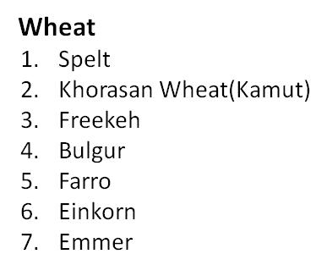
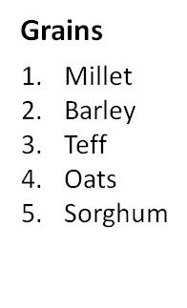
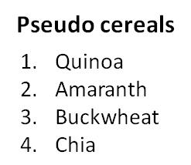
Ancient Grains
Arugula
Celery
Cress
Lettuce
Red beetroot and beet juice
Spinach
Carrot
Beet greens
Chinese
Bok Choy
Rhubarb
Swiss chard
Mustard green
Parsley
Turnips
Leafs:

Slide 21
